Slide 1




Al Delcy
Web Developer & Designer for the Marketing Team at ECOTECH VISIONS
Front-End Web Developer at VIDEOREHEARSER
FREELANCE:
Photographer
Videographer
Certified Creative Crazy Person

Slide 2
Intro to Graphic Design
Crash Course

Slide 3
just want to do your resume?
https://www.kickresume.com/

Slide 4
Front-end & Graphic Design
Front-end Devs who know the basics of design and photography software is a +
Become a well-rounded front end Developer and Designer
Reduce Back & Forth with graphic designer
Save Time & Money (Very Important)
Gain Bragging Rights ← Most important

Slide 5

Visual Software
Lots of them out there that do:
The same thing, online and on the computer
Combination of visual manipulation
Or more than that…
http://www.lifehack.org/articles/technology/the-10-best-photoshop-alternatives-you-need-know.html
Industry Standard:
ADOBE CREATIVE CLOUD (Adobe CC)
ADOBE CREATIVE SUITE (Adobe Cs)
Probably heard about it:
Pdf
Photoshop

Slide 6


Slide 7
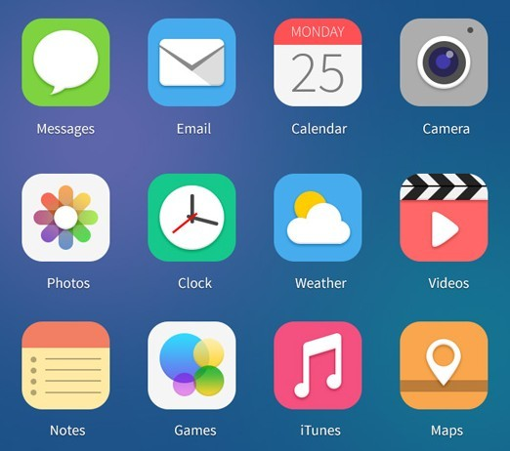

Slide 8
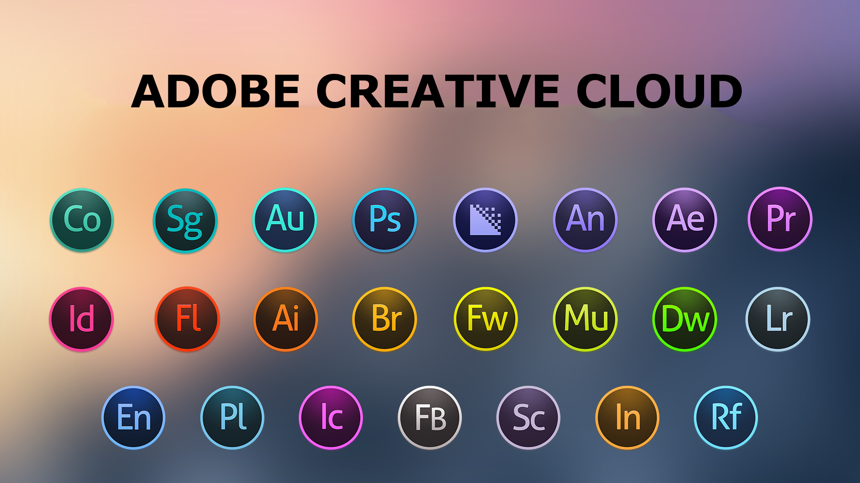

Slide 9
Photography
Graphic Design
Front end Dev

Slide 10



Illustrator
Lightroom
Photoshop

Slide 11
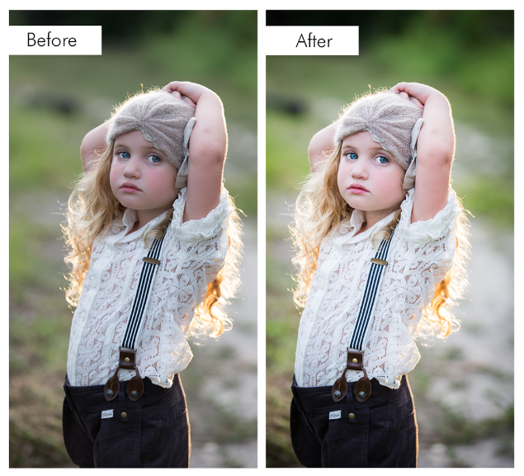

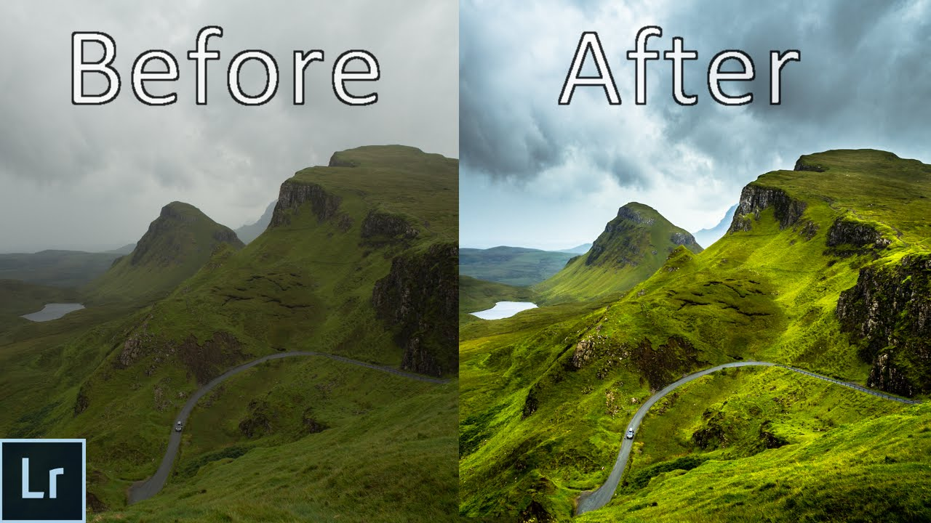
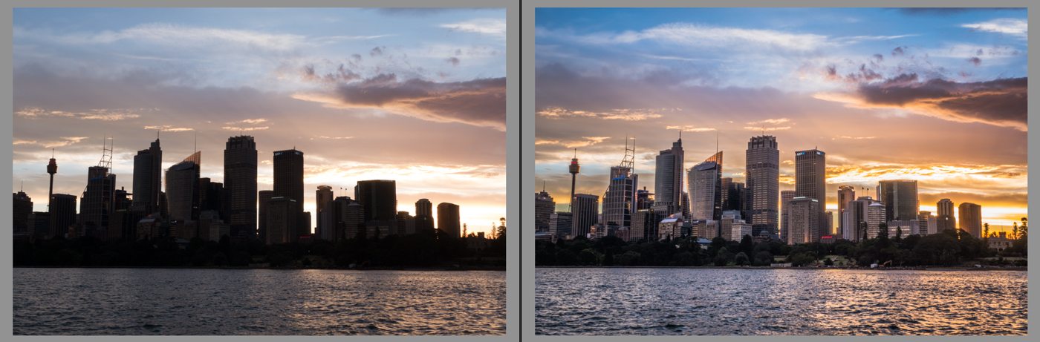
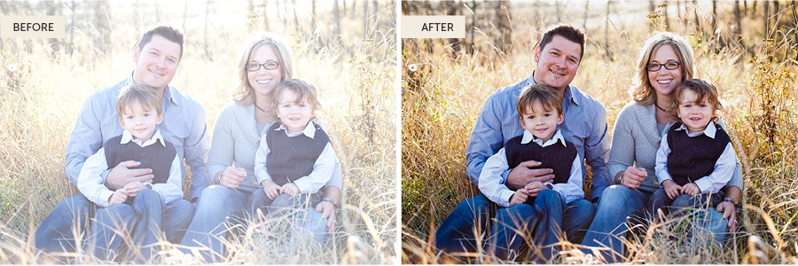
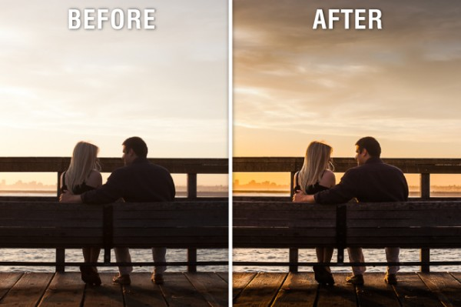



Slide 12
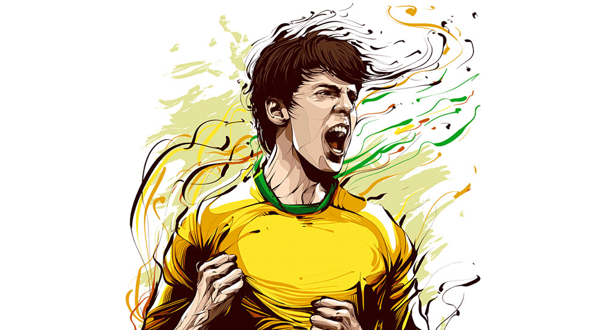

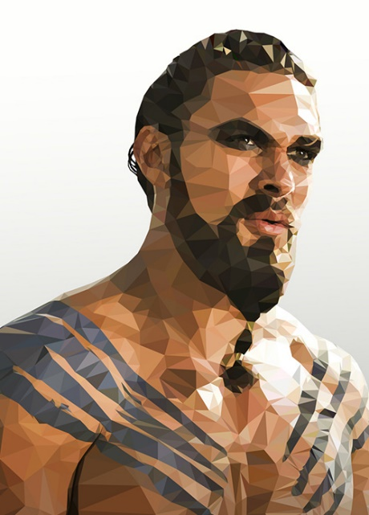


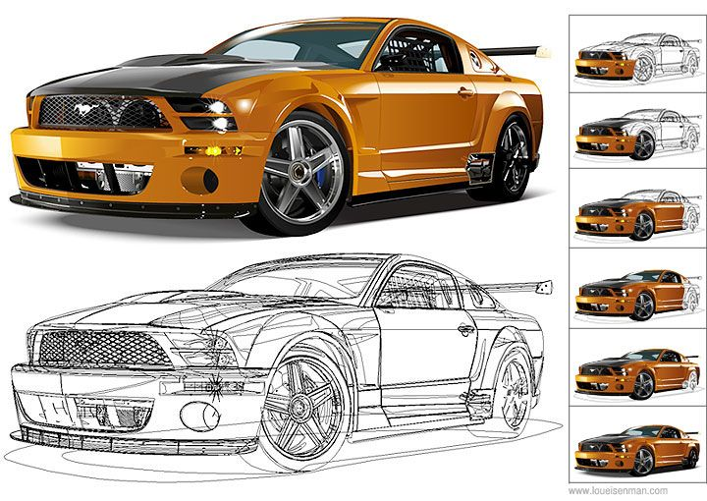




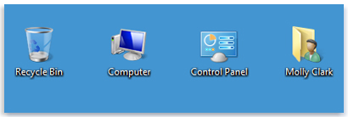


Slide 13
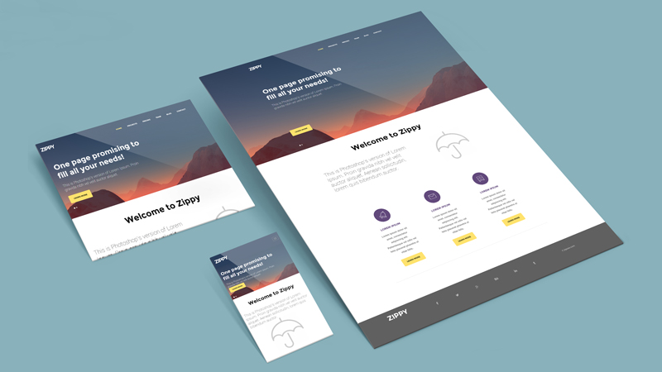
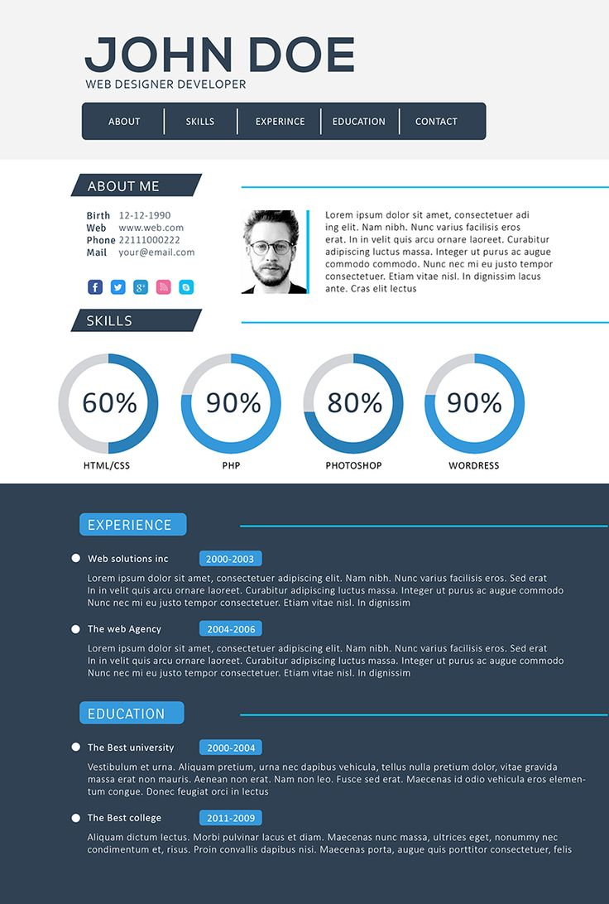
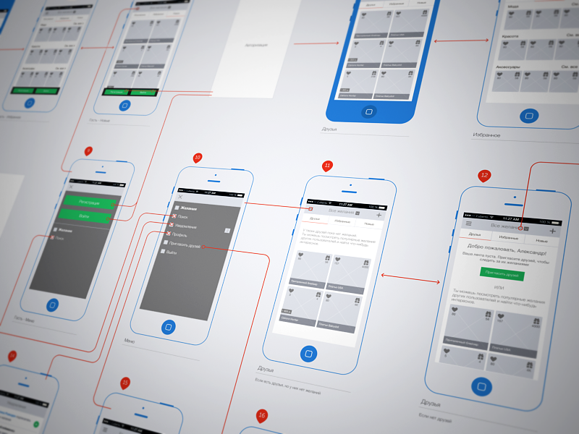
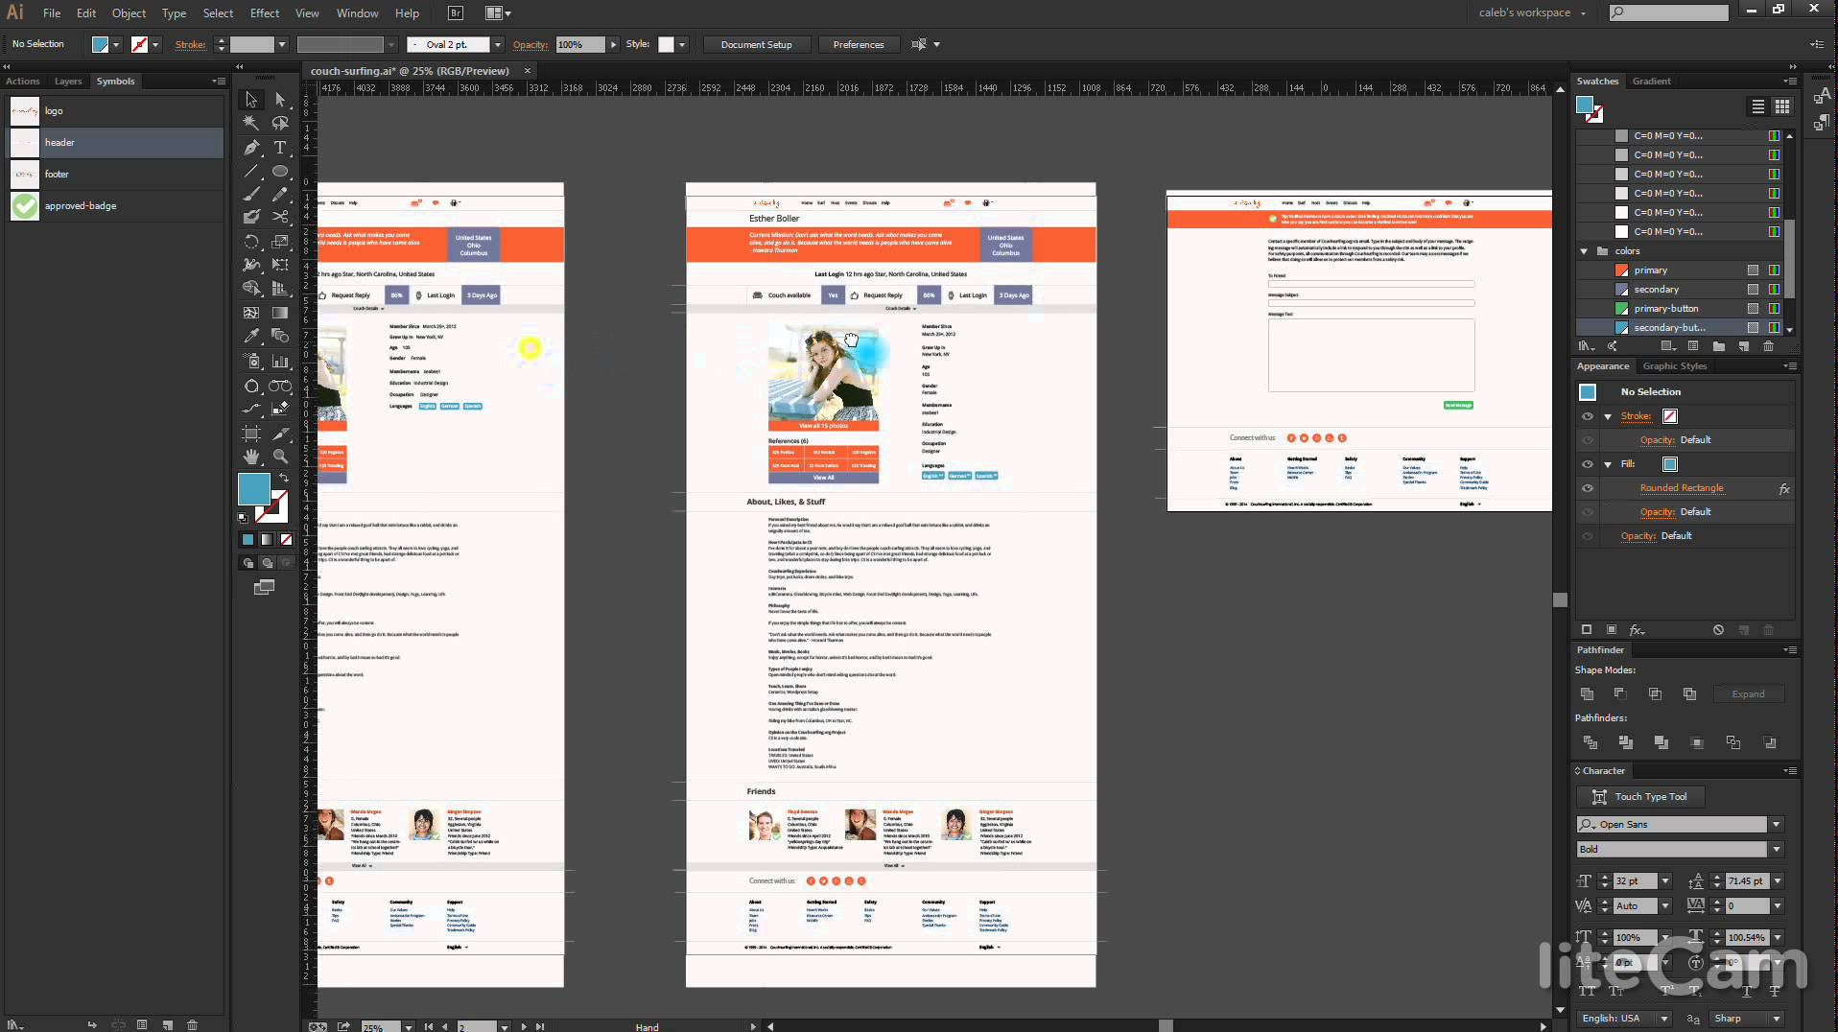

Slide 14
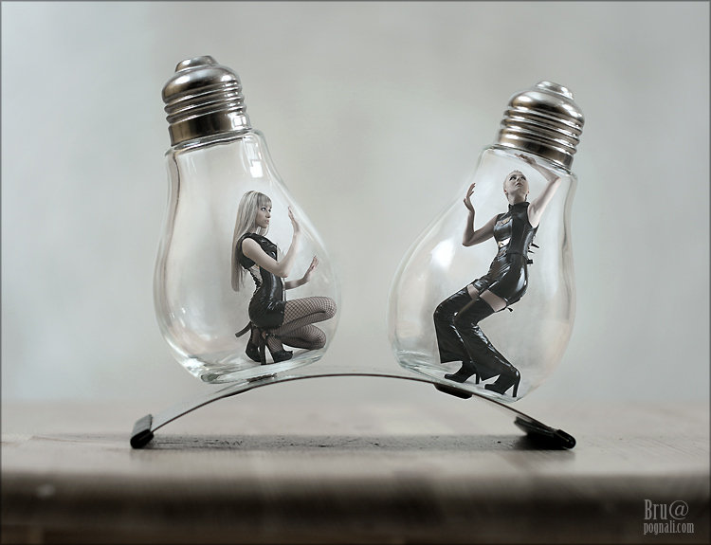

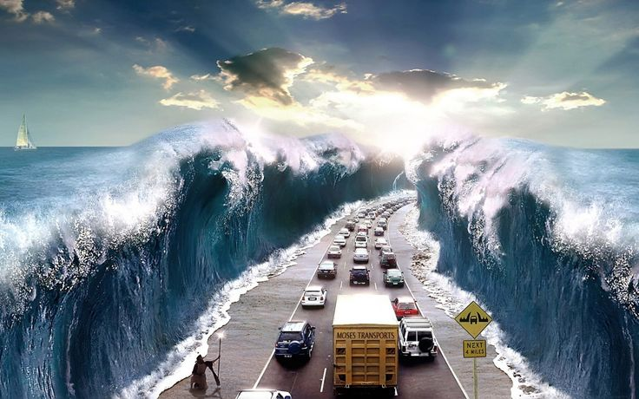

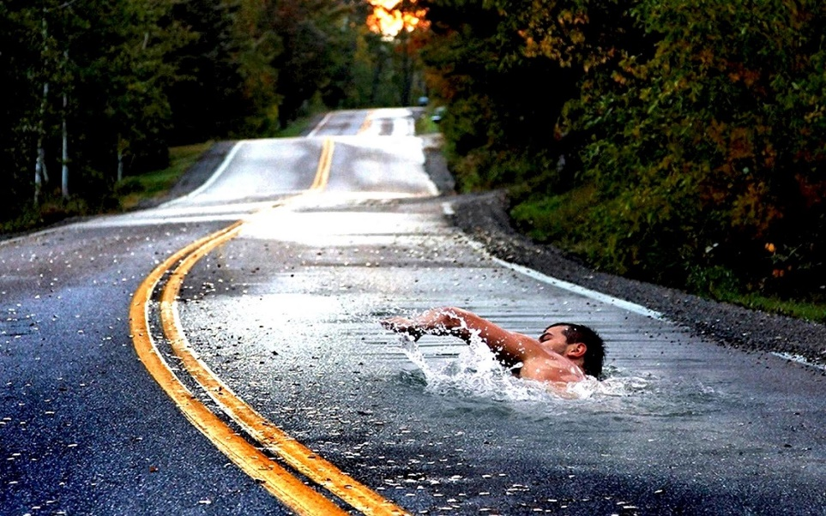

http://webneel.com/webneel/blog/25-creative-photo-manipulation-works-done-photoshop-awesome-collection

Slide 15
Illustrator
Lightroom
Photoshop

Slide 16
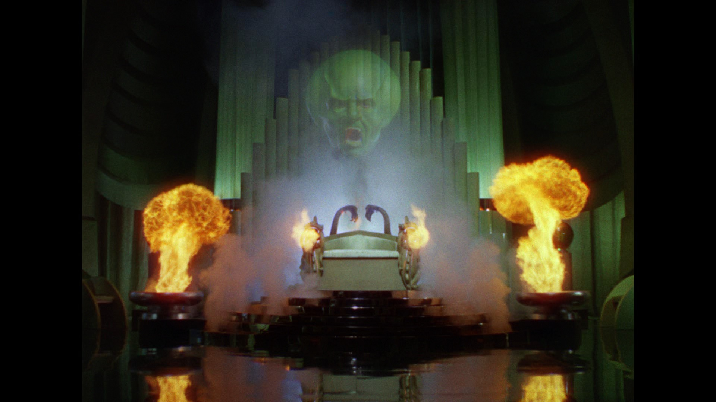

Slide 17


Slide 18
ILLUSTRATOR

Slide 19
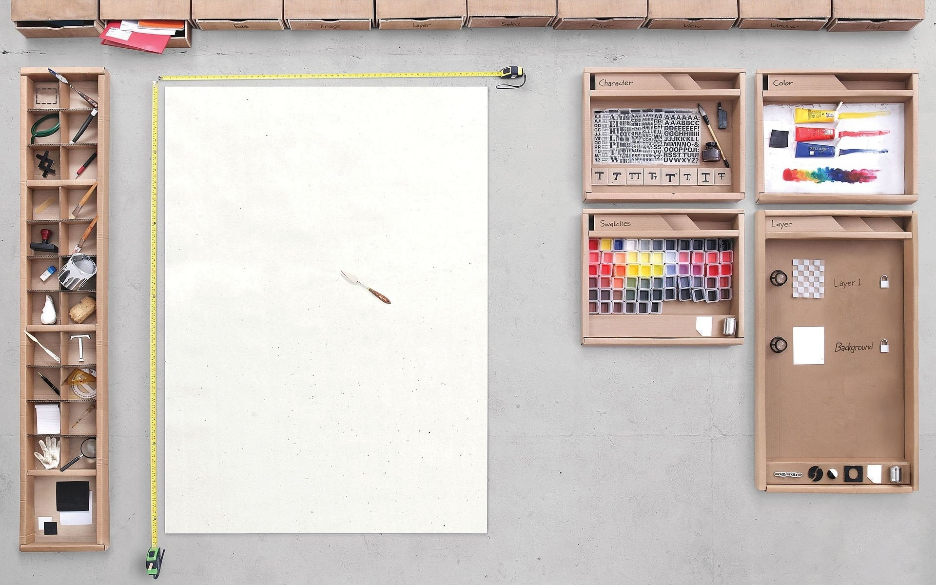

Slide 20
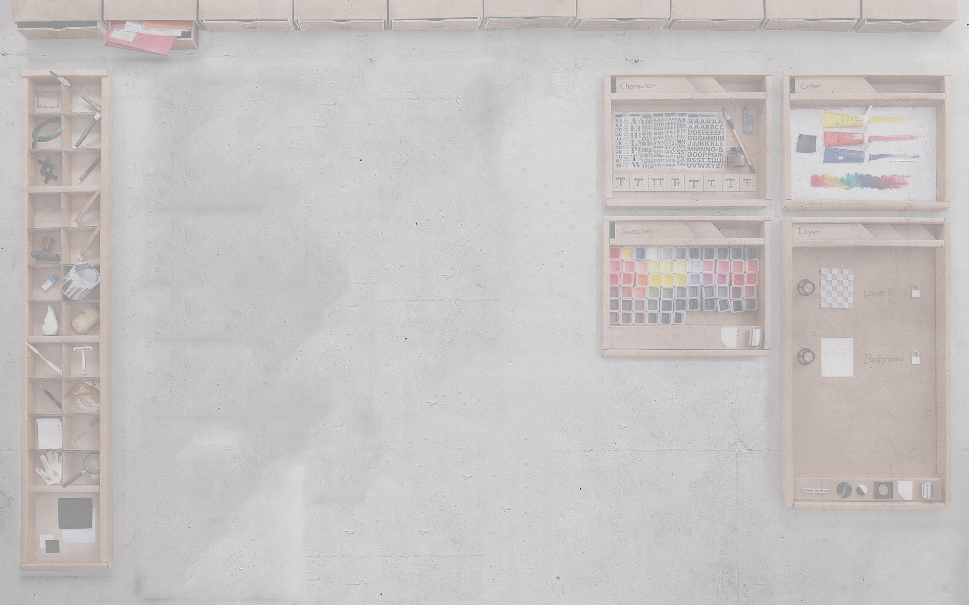


Document Files

Slide 21



Image Files

Slide 22


Editable IMage Files

Slide 23
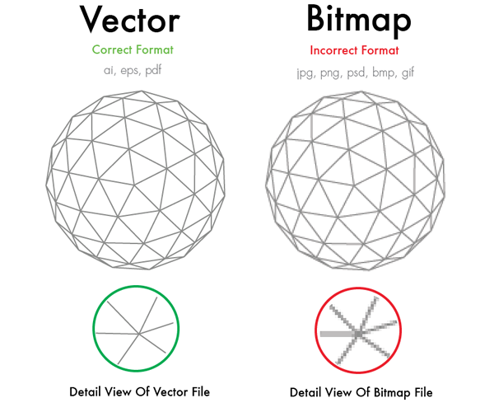

Slide 24
http://www.reggg.com/2013/02/real-life-photoshop.html

Slide 25
What You’re going to learn
Creating a board
Modifying board and its surrounding
Primary tools
Secondary tools
Font / Paragraph
Layers & how they interact
Creating shapes
Modifying shapes
Color, Stroke, Opacity, Properties
Path Finder
External Elements
Placing
Clipping masks
Saving document file
Saving image file
Packaging for external use

Slide 26

We’re NOT sponsored by Apple

Slide 27
Seriously, we’re not

Slide 28
I built my application on Windows 10 & Ubuntu

Slide 29
TONS OF RESOURCES

Slide 30


Slide 31
Search Terms
Vector
AI Icons
SVG Icons
Icon Set
Royalty free
FREE
[name] PNG Vector
[name] PNG Icon

Slide 32
PRE-MADE GRAPHIC TOOLS
Canva
https://www.canva.com/
GRAPHIC RIVER
https://graphicriver.net/
FREE VECTORS
http://www.freevectors.net/
Vecteezy
http://www.vecteezy.com/
… and a lot more

Slide 33

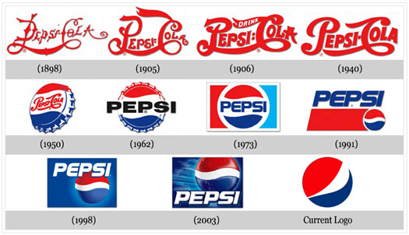
Everything Evolves

Slide 34
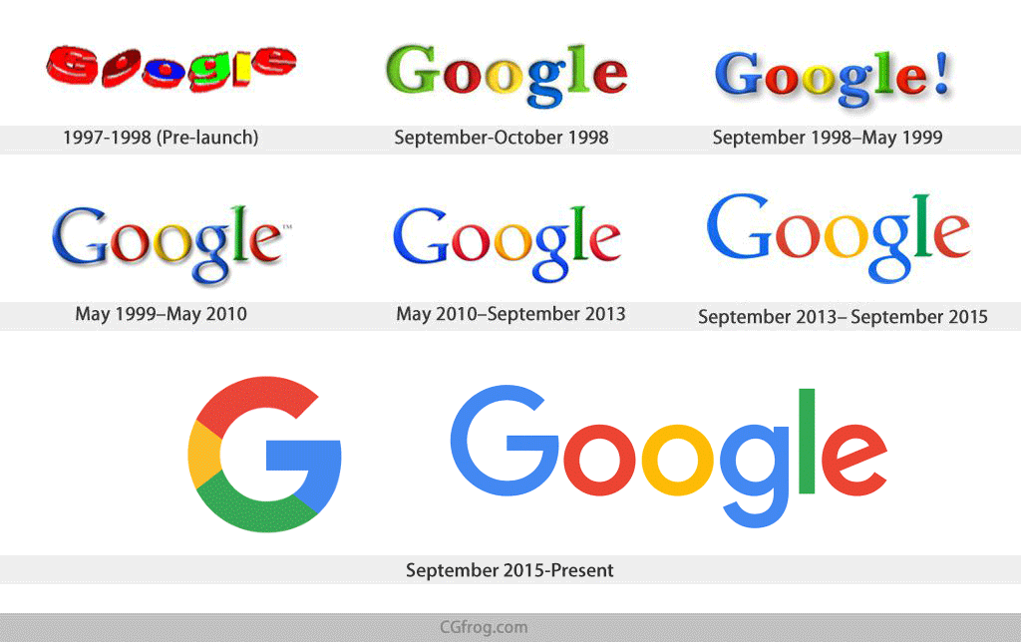
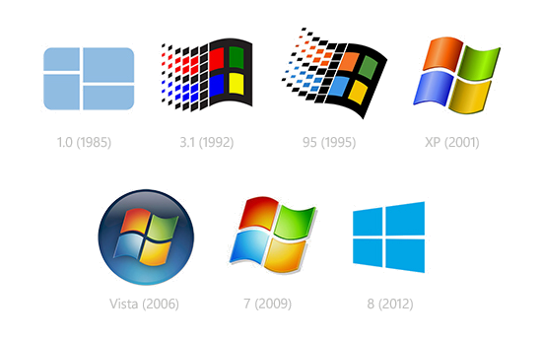

Everything Evolves

Slide 35
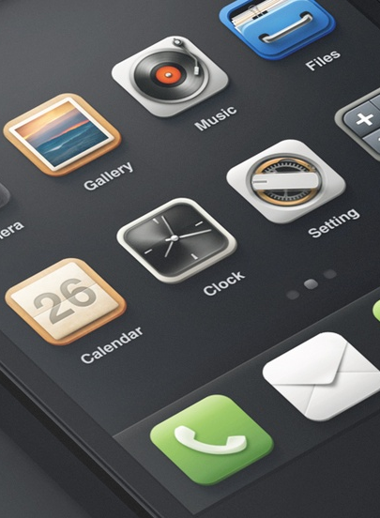
Keep In mind
THINK and PLAN before Designing
Keep it clean and simple
Go easy on the colors
Design what you NEED

Slide 36
SOME DEV ADICE

Slide 37
DESIGN FIRST
CODE LATER

Slide 38

Application Prototyping
www.sketchapp.com
Resources: www.sketchappsources.com

Slide 39


Online Prototyping
www.invisionapp.com
app.moqups.com

Slide 40
READ
PRACTICE
READ
HUSTLE

Slide 41
HUSTLE HARD
Notes:
Note about Sarah, beginner to hired

Slide 42
KEEP CODING
Have one project were you do EVERYTHING from scratch

Slide 43
KEEP READING
seriously

Slide 44
BACKRUB! - GOOGLE
Notes:
Note about Sarah, beginner to hired

Slide 45
ROYALTY FREE PHOTOS
https://picjumbo.com/
https://www.pexels.com/
https://unsplash.com/

Slide 46


Slide 47


Slide 48
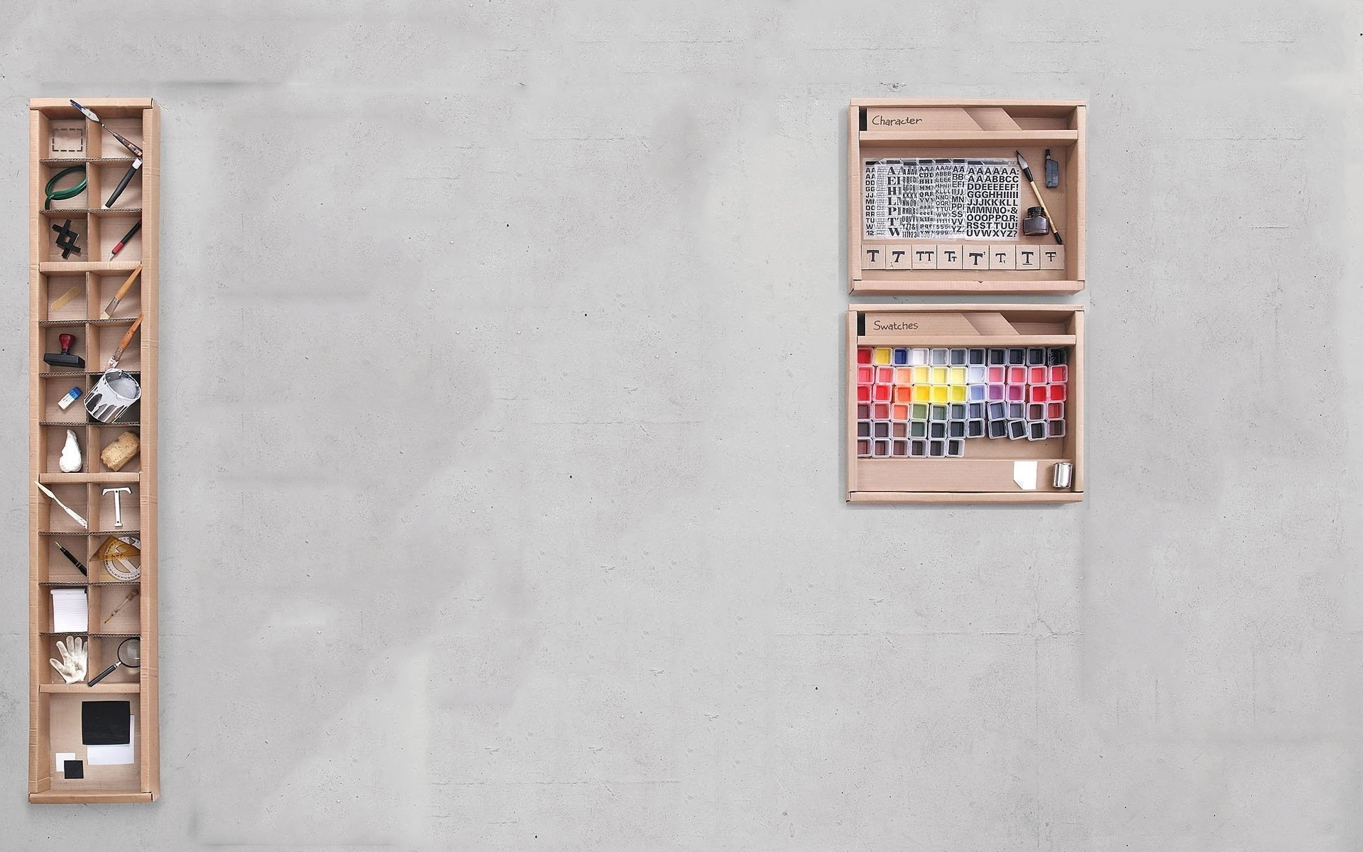

Slide 49
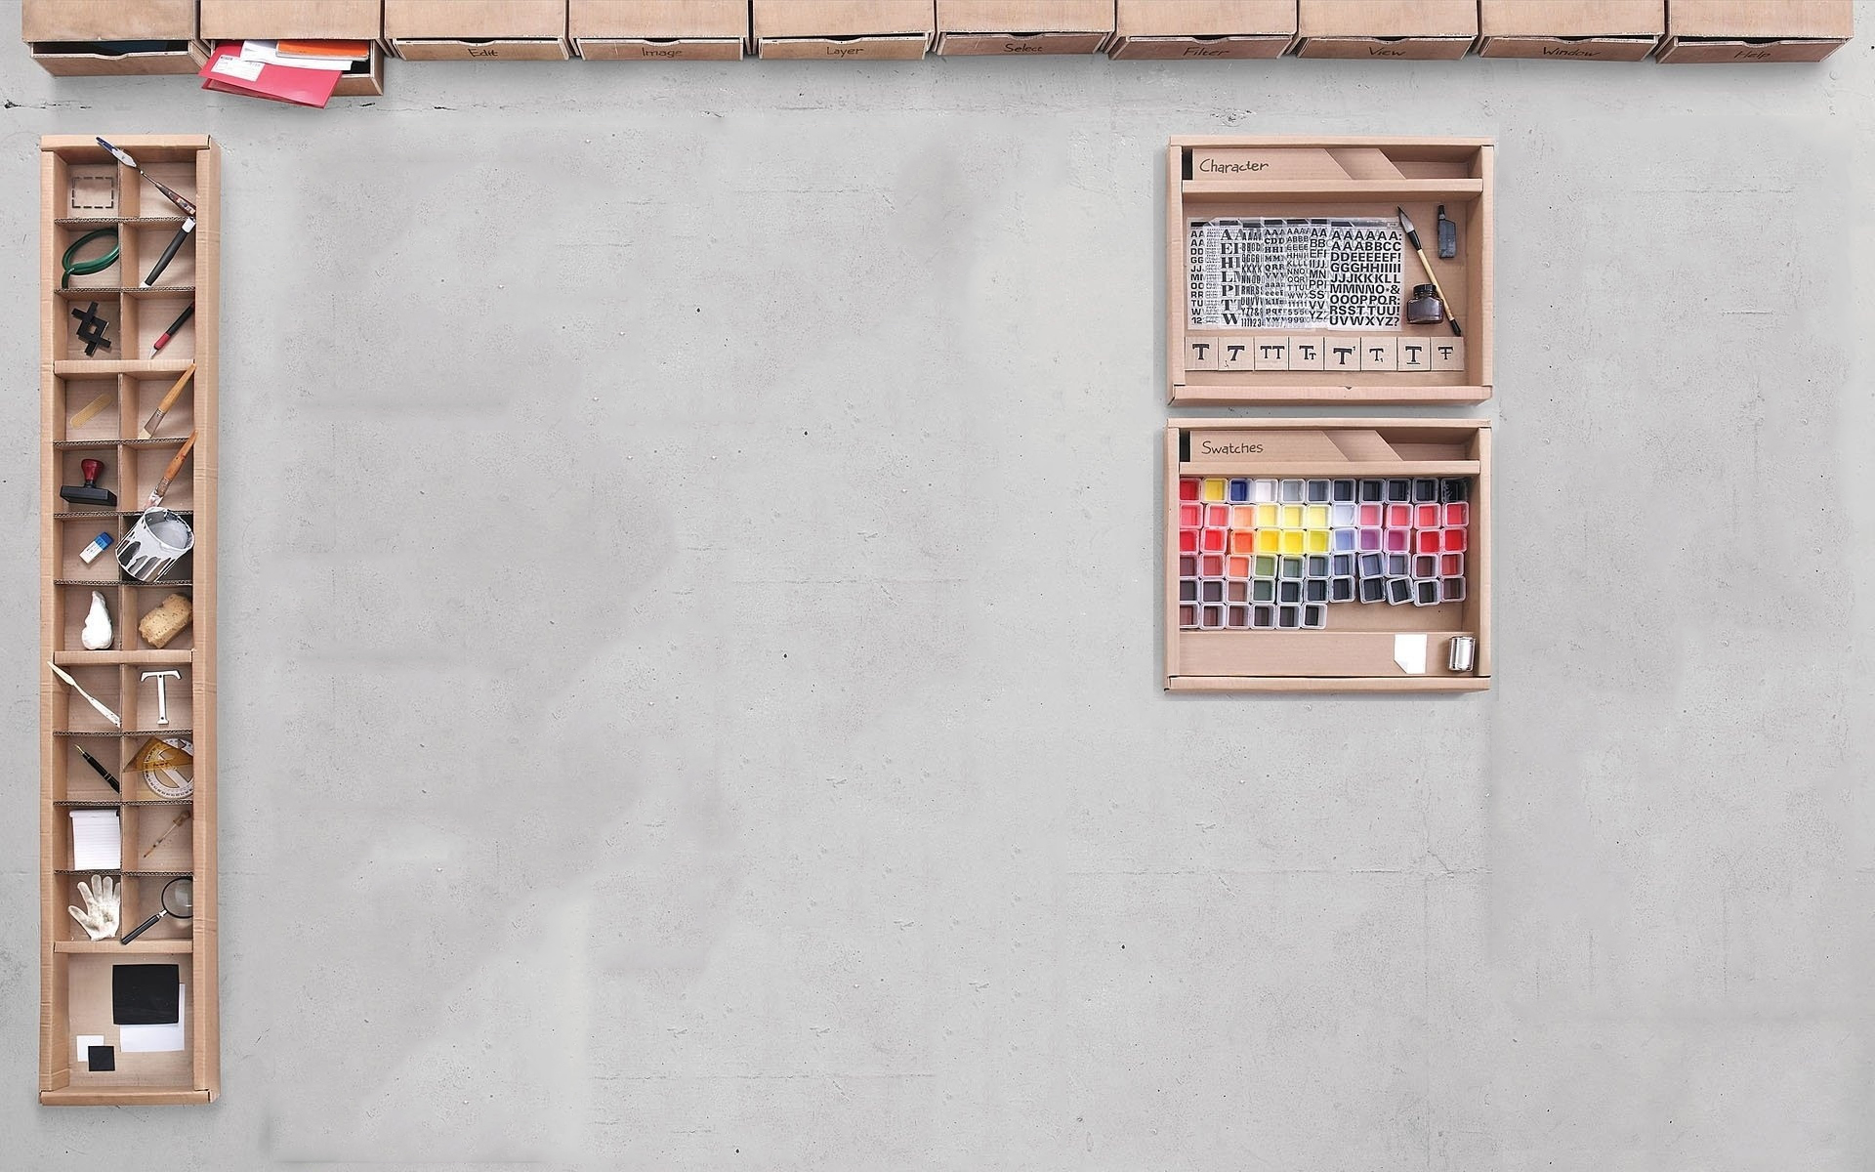

Slide 50
